Slide 1
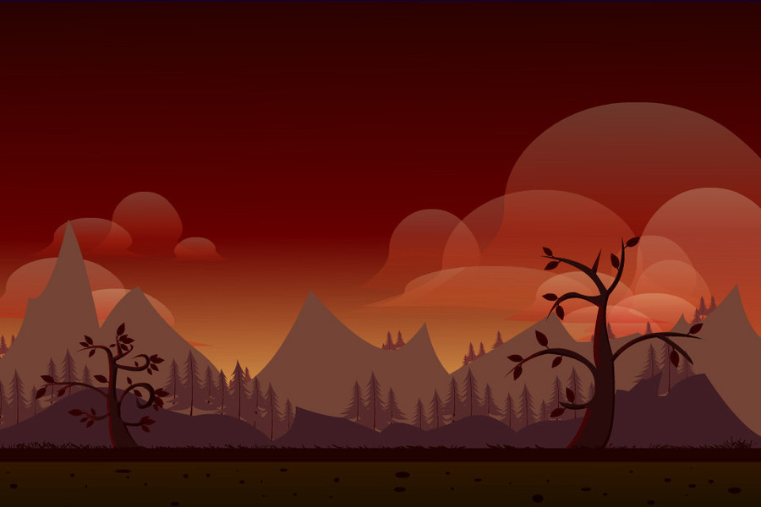

The Undertaker
NEW GAME
TUTORIAL
TEAM “NEW ORLEANS“
LEADER BOARD

Slide 2
ABOUT THE UNDERTAKER
The Undertaker is a GUI video game, written in Java and developed by team New Orleans for the Java Fundamentals teamwork at SoftUni.
The main theme of the game is a battle between a lone soldier, who has to fight with numerous monsters, such as dragons, dinosaurs, etc.

Slide 3


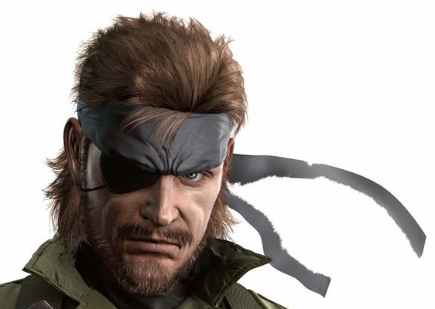
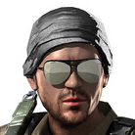

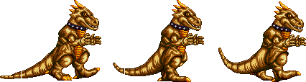
THE TEAM
SIMEON
VANOV
- created the health class
- created the scoring
VIKTORIA
TENEVA
EDWARD
SLAVOV
VIKTOR
MARINOV
KIRIL
TODOROV
Divided the code in different classes and states.
Created the Display, EnemyGenerator, Game, Handler, GameObject and Leaderboard classes
-Created main menu, tutorial and game over states
-Code refactoring
-Debugging
Made player sprite sheet, moving and jumping, added bullets and basic collision,

Slide 4

AND THANK YOU FOR YOUR ATTENTION!

